Slide 1
Final Project MYSQL
Submitted By: Asmat Khan
Batch: 15th July

Slide 2
Task 1
In MYSQL to perform this task firstly I calculated aggregate total sales by branch and month then calculated the monthly sales and in the last query I have found the top performing branch.
The last query is on the next slide and the other first two queries are in the script file attached in the Project.
The Result Tables and the visual representation is of the first two queries only as the last query result consist of only a single row which represented ‘A’ as the Top Branch by Sales Growth Rate.

Slide 3
SQL Query
WITH SalesGrowth AS (
WITH MonthlySalesData AS
( SELECT Branch, DATE_FORMAT(STR_TO_DATE(Date, '%d-%m-%Y'), '%Y-%m') AS SalesMonth, SUM(Total) AS MonthlySales
FROM WalmartSales
GROUP BY Branch, SalesMonth)
SELECT Branch, SalesMonth, MonthlySales, LAG(MonthlySales) OVER (PARTITION BY Branch ORDER BY SalesMonth) AS PreviousMonthlySales, ROUND((MonthlySales - LAG(MonthlySales) OVER (PARTITION BY Branch ORDER BY SalesMonth))/ LAG(MonthlySales) OVER (PARTITION BY Branch ORDER BY SalesMonth) * 100, 2 ) AS GrowthPercentage
FROM MonthlySalesData)
SELECT Branch, ROUND(SUM(GrowthPercentage), 2) AS 'Total_Growth_Percentage'FROM SalesGrowthWHERE GrowthPercentage IS NOT NULL
GROUP BY Branch
ORDER BY Total_Growth_Percentage desc
LIMIT 1 ;

Slide 4
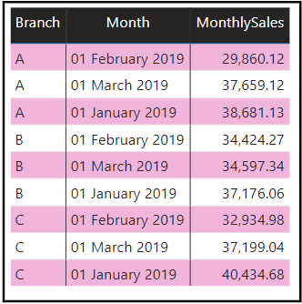
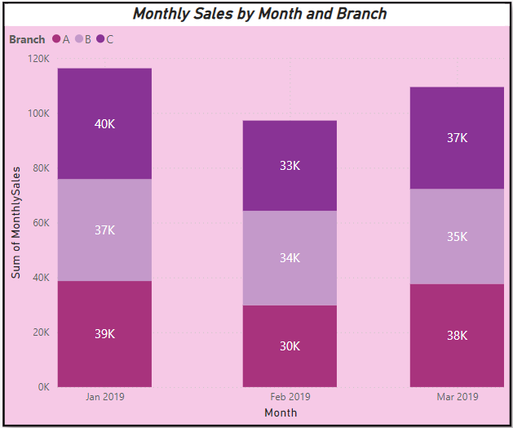
Result Table and Visual Representation

Slide 5
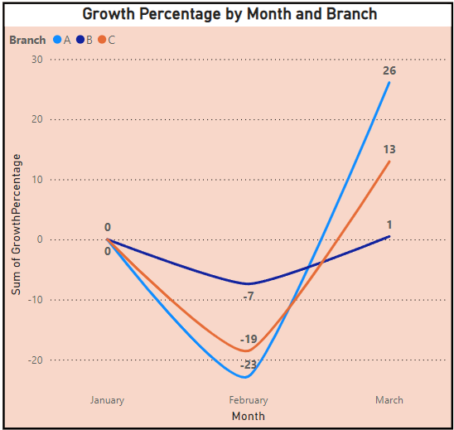
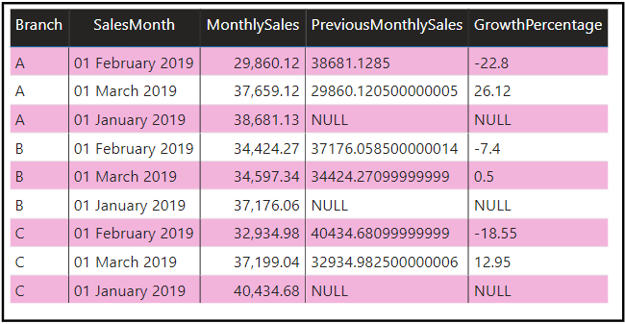

Slide 6
Key Insights For Each Branch
For Branch ‘A’ : A significant decline in February (-22.8%) compared to January, but a strong recovery in March (+26.12%). This suggests that Branch A had some fluctuations, possibly due to external factors, and managed to recover by March.
For Branch ‘B’ : A smaller decline in February (-7.4%) compared to Branch A, followed by a marginal recovery in March (+0.5%). This indicates relatively stable sales performance, but without significant growth or loss in the first quarter.
For Branch ‘C’ : February showed a significant decrease of -18.55%, but Branch C showed a decent recovery in March (+12.95%). The performance trend is similar to Branch A, with a sharp decline followed by a partial recovery.
Recommendations
Investigate February Declines: It's important to investigate what caused the significant declines in February for Branches A and C. External factors like seasonal demand, pricing strategies, or inventory issues could have impacted sales.
Focus on Stability: Branch B's relatively stable performance can be a model for other branches. Understanding what contributed to its stability in comparison to others may help improve overall sales consistency.

Slide 7
Task 2 MYSQL Queries
To find the product lines in each Branch with highest profit:
WITH ProductLineProfit AS (SELECT Branch, `Product line`,
SUM(cogs-'gross income') AS Profit, ROW_NUMBER() OVER (PARTITION BY Branch ORDER BY SUM(cogs-'gross income') DESC) AS Rnk
FROM WalmartSales GROUP BY Branch, `Product line`)
SELECT Branch, `Product line`, ProfitFROM ProductLineProfit
where Rnk = 1;

Slide 8
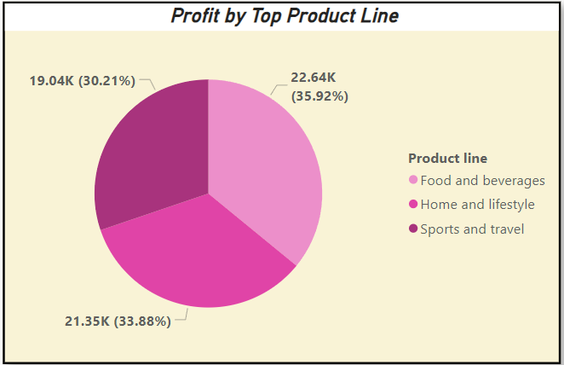
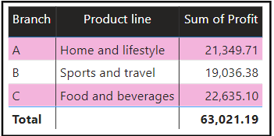
Table and Chart for the Query

Slide 9
2. To rank each Product Line According to each Branch:
SELECT Branch, `Product line`, SUM(cogs-'gross income') AS Profit,
RANK() OVER (PARTITION BY Branch ORDER BY SUM(cogs-'gross income') DESC) AS Rk
FROM WalmartSales
GROUP BY Branch, `Product line`
ORDER BY Branch, Rk;

Slide 10
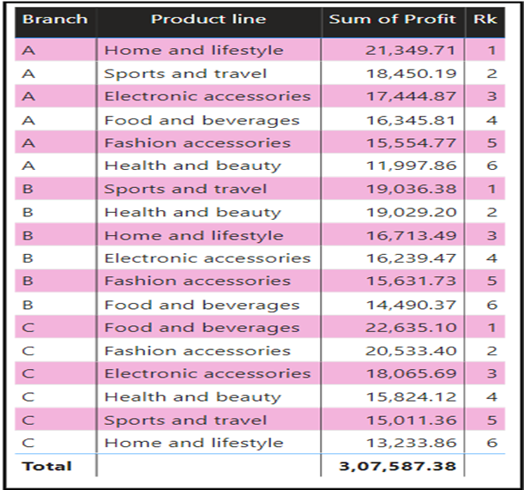
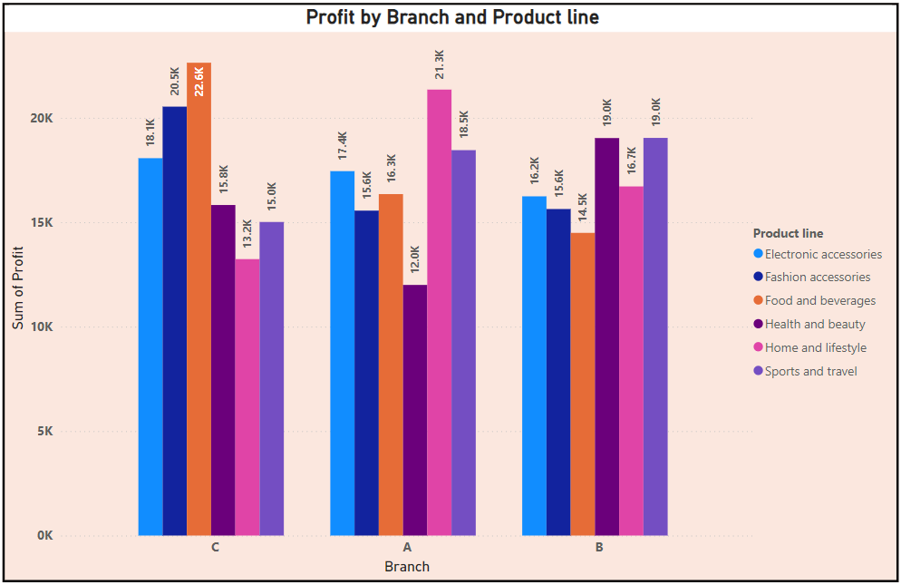
Table and Chart for the Second Query

Slide 11
Key Insights for each Branch
Branch A: The highest profit was generated by the Home and Lifestyle product line, contributing 21,349.71 to the total profit.
This indicates that customers in this branch likely prefer products related to home and lifestyle,
making it a key focus area for boosting sales and promotions.
Branch B: The Sports and Travel product line stands out with a profit of 19,036.38.
This suggests that Branch B serves customers with a significant interest in outdoor and
recreational activities. Marketing campaigns targeting sports enthusiasts and travelers could
further enhance sales.
Branch C: The top-performing product line is Food and Beverages, generating a profit of 22,635.10.
This highlights the dominance of consumables in this branch, possibly due to high demand for
everyday essentials. Maintaining inventory and offering deals on these items could further
capitalize on customer preferences.

Slide 12
Task 3 MYSQL Query
#Customer Segmentation based on spending:
WITH CustomerSpending AS (
SELECT `Customer ID`, SUM(Total) AS TotalSpending
FROM WalmartSales
GROUP BY `Customer ID`),SpendingStats AS (
SELECT AVG(TotalSpending) AS AvgSpending,
STDDEV(TotalSpending) AS SpendingDeviation
FROM CustomerSpending)

Slide 13
SELECT cs.`Customer ID`, cs.TotalSpending,
CASE
WHEN cs.TotalSpending >= ss.AvgSpending + ss.SpendingDeviation THEN 'High Spender'
WHEN cs.TotalSpending >= ss.AvgSpending - ss.SpendingDeviation AND cs.TotalSpending < ss.AvgSpending + ss.SpendingDeviation THEN 'Medium Spender'
ELSE 'Low Spender'
END AS SpendingTier
FROM CustomerSpending cs
CROSS JOIN SpendingStats ss
ORDER BY cs.TotalSpending desc;

Slide 14
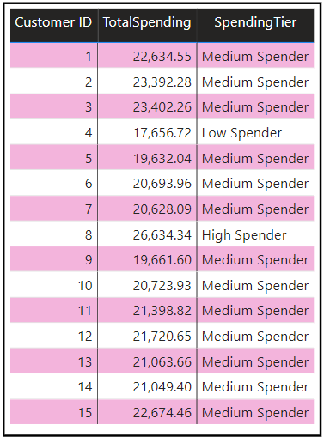
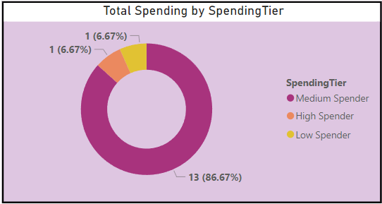
Table and Chart for the Query
Note: The table here is not the complete table as the complete table is so big that I cannot insert the whole table but only a sample. The complete table is added in the project folder in excel format

Slide 15
Key Insights
High Spender: Only one customer (ID 8) falls into this category, with a total spending of 26,634.34. This indicates that the threshold for being a High Spender is significantly higher than the majority of the dataset.2.
Medium Spenders: The majority of customers, specifically 14, fall into the Medium Spender category. Their spending ranges from 19,632.04 to 23,402.26.This tier constitutes the largest group, suggesting that most customers spend close to the average.3.
Low Spender: Only one customer (ID 17656) is classified as a Low Spender, with spending at 17,656.72. This indicates that customers who spend significantly less than the average are rare in the dataset.

Slide 16
Task 4 MYSQL Query
#Detecting Anomalies in Sales Transaction
WITH ProductLineStats AS
(
SELECT `Product line`, AVG(Total) AS AvgSales
FROM WalmartSales
GROUP BY `Product line`
),
AnomalousTransactions AS (

Slide 17
SELECT ws.`Invoice ID`, ws.Branch, ws.`Product line`, ws.Total AS SaleAmount, pls.AvgSales,
CASE
WHEN ws.Total > pls.AvgSales*1.2 THEN 'High Anomaly'
WHEN ws.Total < pls.AvgSales*0.8 THEN 'Low Anomaly'
ELSE 'Normal'
END AS AnomalyType
FROM WalmartSales ws
JOIN ProductLineStats pls ON ws.`Product line` = pls.`Product line
)
SELECT `Invoice ID`, Branch, `Product line`, SaleAmount, AnomalyType
FROM AnomalousTransactions
WHERE AnomalyType IN ('High Anomaly', 'Low Anomaly’)
ORDER BY SaleAmount;

Slide 18
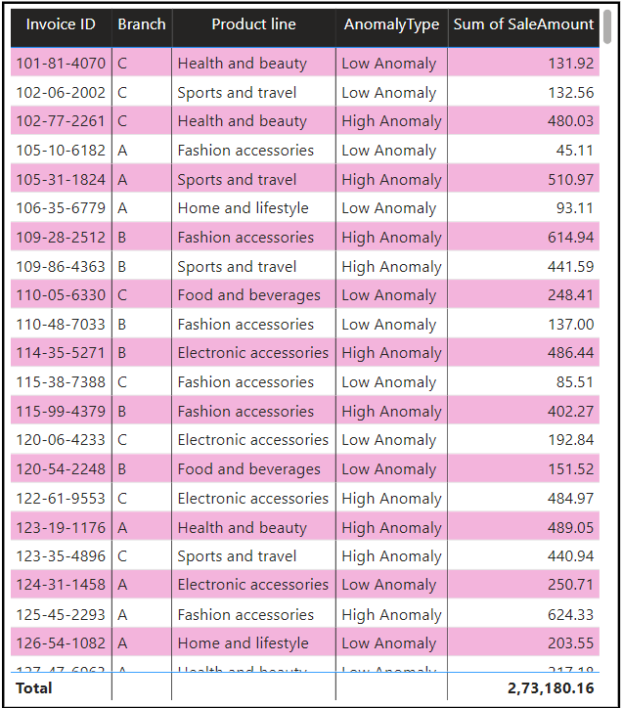
Table for the Query
Note: The table here is not the complete table as the complete table is so big that I cannot insert the whole table but only a sample. The complete table is added in the project folder in excel format

Slide 19
Key Insights
High Anomalies: These transactions represent sales that are significantly higher than the average for their product line.
They could indicate:
Bulk Purchases: A few large orders could skew the results, potentially from business-to-
business (B2B) clients or special promotions.
Data Entry Errors: There might be data entry mistakes, such as extra zeros or incorrect
prices.
Low Anomalies: These transactions represent sales that are much lower than the average for the product line.
Possible reasons include:
Discounts or Promotions: Sales during promotional periods might have resulted in lower
prices, causing the total sales to drop below the typical range.
Product Availability Issues: Low sales could indicate product shortages or stockouts, where
customers couldn't purchase the desired items.

Slide 20
Task 5 MYSQL Query
#Most Popular Payment Method by City
With PaymentCounts as(
Select City, Payment, count(Payment) as PaymentCountfrom walmartsales
group by City, Payment),
RankedPayments as(
Select city, Payment, PaymentCount, Row_number() over(Partition by City order by PaymentCount desc) as Rnkfrom PaymentCounts)
select city, Payment, PaymentCountfrom RankedPayments
where Rnk = 1
Order by City;

Slide 21
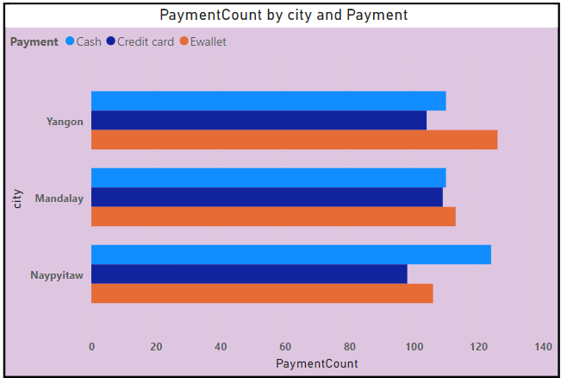
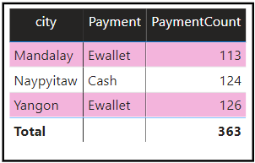
Table and Chart for the Query

Slide 22
Key Insights
Mandalay: EWallet is the most popular payment method, with 113 transactions. This suggests that customers in Mandalay prefer digital payments over cash. Walmart could consider promoting EWallet-specific discounts or loyalty rewards to capitalize on this trend.2.
Naypyitaw: Cash is the most popular payment method in Naypyitaw, with 124 transactions. This indicates a preference for physical payments in this city. Walmart might want to consider enhancing cash payment convenience, such as adding more cash payment options at checkout or offering promotions specifically targeting cash users.3.
Yangon: EWallet leads as the most popular payment method, with 126 transactions, similar to Mandalay. The growing preference for EWallets in major cities like Yangon suggests a shift toward digital payments. Walmart can focus on further promoting EWallet options and consider partnerships with EWallet providers to offer exclusive deals for customers in Yangon.

Slide 23
Task 6 MYSQL Query
#Monthly Sales Distribution by Gender:
Select Gender,
DATE_FORMAT(STR_TO_DATE(Date, '%d-%m-%Y'), '%Y-%m') AS Month,
Round(sum(Total), 2) as TotalSales
from walmartsales
group by Gender, Monthorder by Month, Gender;

Slide 24
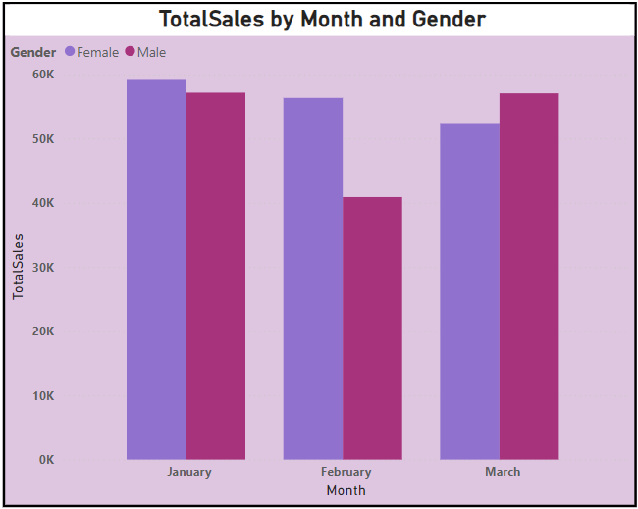
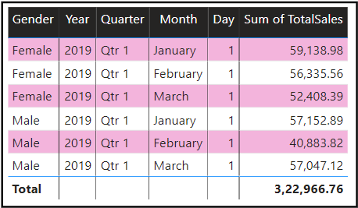
Table and Chart for the Query

Slide 25
Key Insights
Overall Sales Performance:
In January 2019, female customers contributed slightly more to sales (59,138.98) compared to male customers (57,152.89), showing a small difference of approximately 3.4%.
In February 2019, female customers again dominated the sales (56,335.56), significantly outperforming male customers (40,883.82) by around 37.8%.
However, in March 2019, the trend shifted as male customers contributed more (57,047.12) than female customers (52,408.39), outpacing them by approximately 8.9%.2.
Spending Trends:
Female customers led in sales for two out of three months (January and February), indicating a consistent pattern of higher spending during this period.
Male customers had a stronger performance in March, suggesting potential seasonal or promotional factors that influenced spending.
Monthly Sales Variations:
Both genders experienced fluctuations in spending across the months. Female sales peaked in January and slightly declined in February and March.
Male sales were the lowest in February, indicating a potential area for Walmart to explore why male spending dropped significantly during this month.

Slide 26
Task 7 MYSQL Query
#Best Product Line by Customer Type
Select `Customer type`, `Product line`, count(*) as count_of_PL
from walmartsales
group by `Customer type`, `Product line`
order by `Customer type`, count_of_PL desc;

Slide 27
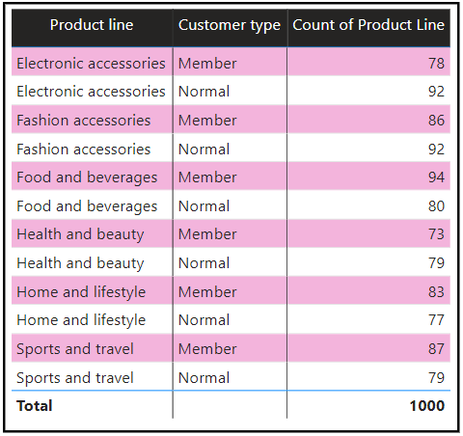
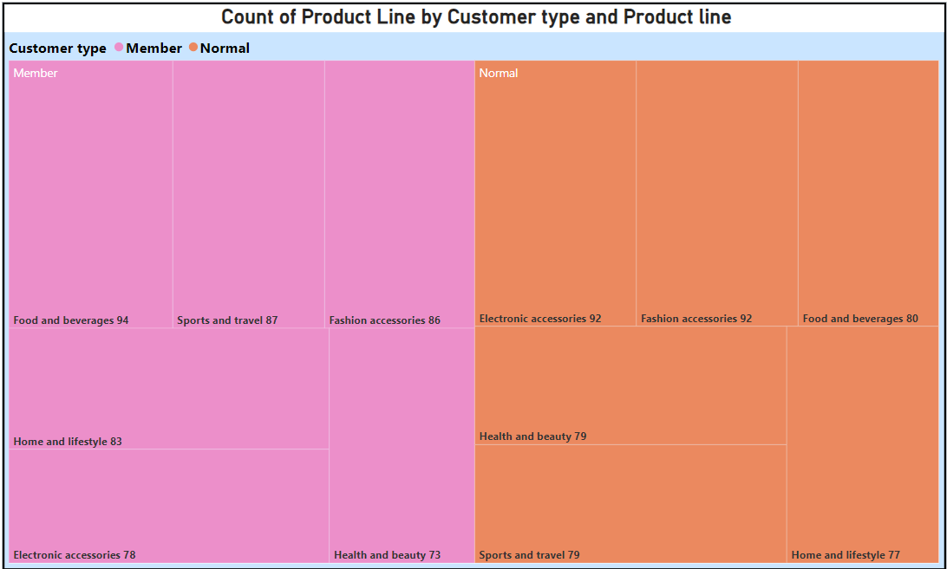
Table and Chart for the Query

Slide 28
Key Insights
Top Product Lines for Members:
The most preferred product line for Members is Food and Beverages with 94 transactions, followed
closely by Sports and Travel (87) and Fashion Accessories (86).
Members also show strong interest in categories like Home and Lifestyle (83), Electronic Accessories
(78), and Health and Beauty (73).
Top Product Lines for Normals:
For Normal customers, the most popular product lines are Electronic Accessories and Fashion
Accessories, each with 92 transactions, showing high engagement in tech and fashion.
Other highly preferred categories include Food and Beverages (80), Sports and Travel (79), and Health
and Beauty (79).
Comparison Between Member and Normal:
There are noticeable shifts in preferences between customer types. Electronic Accessories and Fashion
Accessories are equally preferred by Normals (92), while these categories rank lower for Members.
Food and Beverages stands out as the most preferred product line for Members, while it ranks third for
Normals.

Slide 29
Task 8 MYSQL Query
#Identifying Repeat Customers:
WITH CustomerPurchases AS
(
SELECT `Customer ID`, Date AS PurchaseDate,
LEAD(Date) OVER (PARTITION BY `Customer ID` ORDER BY STR_TO_DATE(Date, '%d-%m-%Y')) AS NextPurchaseDate
FROM WalmartSales
),

Slide 30
RepeatPurchases AS
(
SELECT `Customer ID`, STR_TO_DATE(PurchaseDate, '%d-%m-%Y') AS PurchaseDate, STR_TO_DATE(NextPurchaseDate, '%d-%m-%Y') AS NextPurchaseDate, DATEDIFF(STR_TO_DATE(NextPurchaseDate, '%d-%m-%Y’),
STR_TO_DATE(PurchaseDate, '%d-%m-%Y')) AS DaysBetween
FROM CustomerPurchases
WHERE NextPurchaseDate IS NOT NULL
)
SELECT `Customer ID`, PurchaseDate, NextPurchaseDate, DaysBetweenFROM RepeatPurchases
WHERE DaysBetween <= 30
ORDER BY `Customer ID`, PurchaseDate;

Slide 31
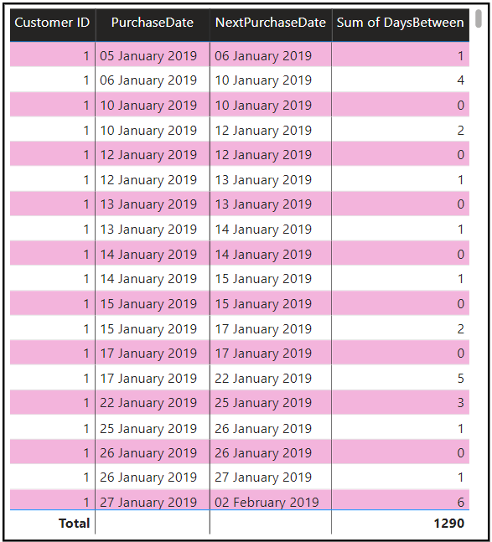
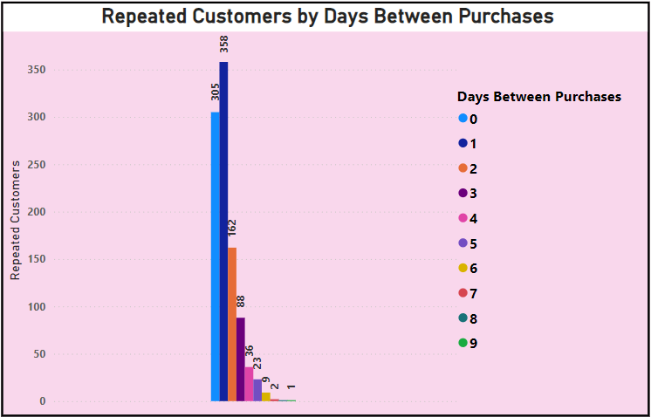
Table and Chart for the Query

Slide 32
Key Insights
Short Purchase Intervals: The DaysBetween column shows that repeat purchases occur within 0 to 5 days for different customers. This indicates a significant number of customers are returning to make purchases shortly after their initial transaction, suggesting high engagement and satisfaction with Walmart's offerings.
Potential Reasons for Quick Repeat Purchases: Customers might be purchasing complementary products or forgotten items from their initial shopping trip. There could be promotional offers or discounts encouraging quick return visits.
Customer Loyalty Opportunities: Customers making repeat purchases in such a short time frame may have a high lifetime value. Walmart can target these customers with loyalty programs or exclusive offers to further increase retention and satisfaction.
Product-Specific Patterns: Analyzing the products purchased during these quick intervals might reveal specific categories driving repeat purchases, such as consumables or essentials.

Slide 33
Task 9 MYSQL Query
#Finding Top 5 Customers by Sales Volume:
SELECT `Customer ID`, ROUND(SUM(Total), 2) AS TotalRevenue, rank() over (order by sum(Total) desc) as 'Rank’
FROM WalmartSales
GROUP BY `Customer ID`
order by TotalRevenue desc
LIMIT 5;

Slide 34
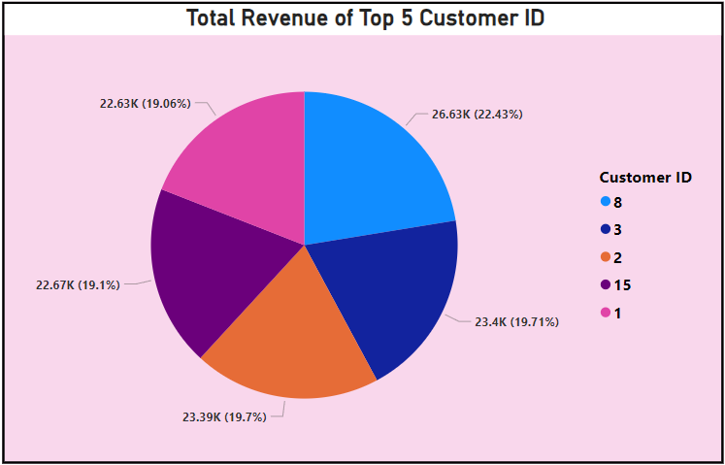
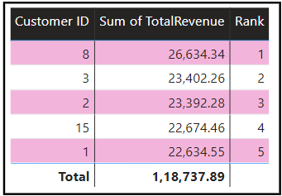
Table and Chart for the Query

Slide 35
Key Insights
Top Performer: Customer 8 leads the ranking with a total revenue of 26,634.34, significantly higher than other customers, making them Walmart's most valuable customer in terms of revenue.
Close Competition: Customers 3 and 2 have comparable revenues, 23,402.26 and 23,392.28, respectively, suggesting a close competition for the 2nd and 3rd spots.
High-Value Customers: The top 5 customers contribute a significant portion of the total revenue, highlighting their importance for loyalty programs and targeted marketing campaigns.
Retention Opportunity: Ensuring personalized engagement strategies for these customers can help maintain their loyalty and potentially increase their spending further.
Revenue Gap: A noticeable gap exists between the highest contributor (Customer 8) and the rest, indicating a need to identify ways to increase spending among the 2nd to 5th ranked customers.

Slide 36
Task 10 MYSQL Query
#Which day of the week brings the highest sales:
SELECT rank() over (order by sum(Total) desc) as 'Rank',
DAYNAME(STR_TO_DATE(Date, '%d-%m-%Y')) AS DayOfWeek,
Round(SUM(Total),2) AS TotalSales
FROM WalmartSales
GROUP BY DayOfWeek
order by TotalSales desc;

Slide 37
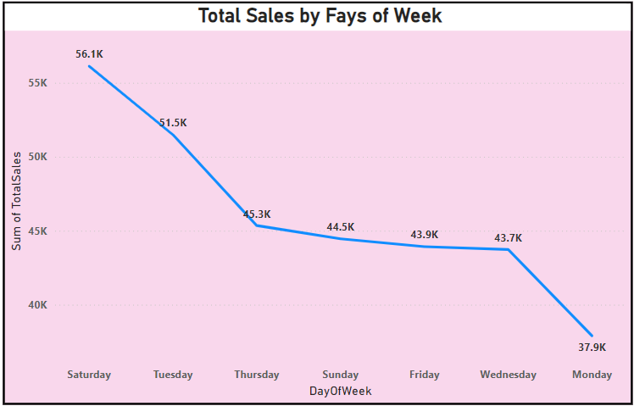
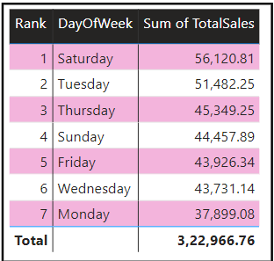
Table and Chart for the Query

Slide 38
Key Insights
Top Performer - Saturday: Saturday generates the highest sales at 56,120.81, significantly outperforming other days. This could be due to increased shopping activity over the weekend when more customers are available.2.
Strong Performance on Tuesdays and Thursdays: Tuesday ranks second with 51,482.25, followed by Thursday at 45,349.25. Both days show strong sales, which might indicate that mid-week promotions or customer habits are contributing to higher sales.
Consistent Weekend Sales: Sunday comes in fourth with 44,457.89, and Friday follows closely behind with 43,926.34, highlighting that the weekend (especially Saturday and Sunday) plays a critical role in driving sales.
Mid-Week Lull: Wednesday and Monday have the lowest sales, with 43,731.14 and 37,899.08, respectively. This could suggest a lull in sales activity at the start of the week or customers waiting for weekend promotions.
Focus on Weekend and Weekday Promotions: Walmart could focus on bolstering promotions or marketing campaigns on weekdays like Tuesday and Thursday to boost sales, while continuing to offer attractive deals on Saturdays and Sundays.

Slide 39
Explanation Video Link:
https://drive.google.com/file/d/1qkQ6-9RP3PFz--cWtr08QeT_8VebsdHW/view?usp=sharing

Slide 40
Thank You

